Slide 1
Hotel aggregator

Slide 2
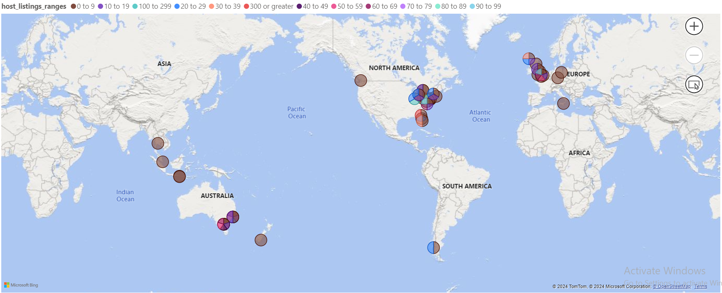
The distribution of host listing according to neighborhoods
- At first, I categorized the host listing into ranges to be clear and visualization.
- The most distributed range is (0-9) and this range existed at most in Europe.
- The second most distributed range is (20-29) and this range existed at most in North America.
- Other ranges distributed randomly between Europe, North and South America and Australia.

Slide 3
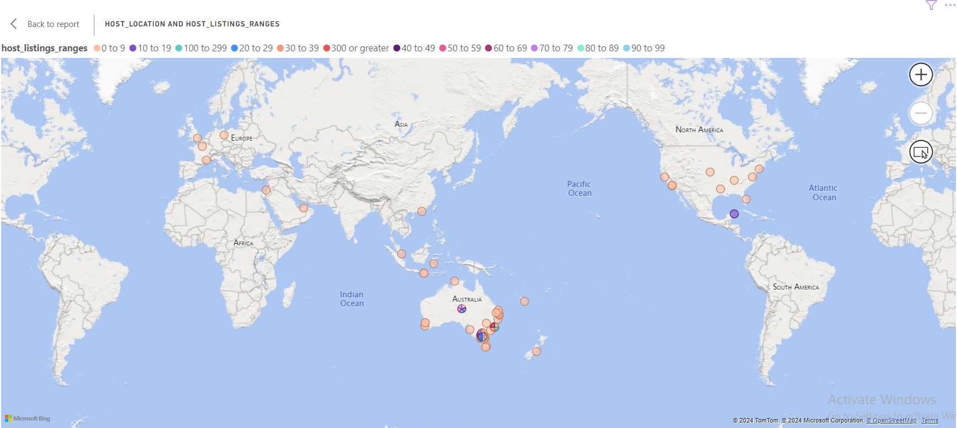
The Geographical concentration of listings and host locations
- Worked with the same categorized column and host location.
- The most distributed range is (0-9) and this range existed at most in Europe, Australia, North America and parts from Asia.
- Other ranges distributed randomly between North America and Australia.

Slide 4
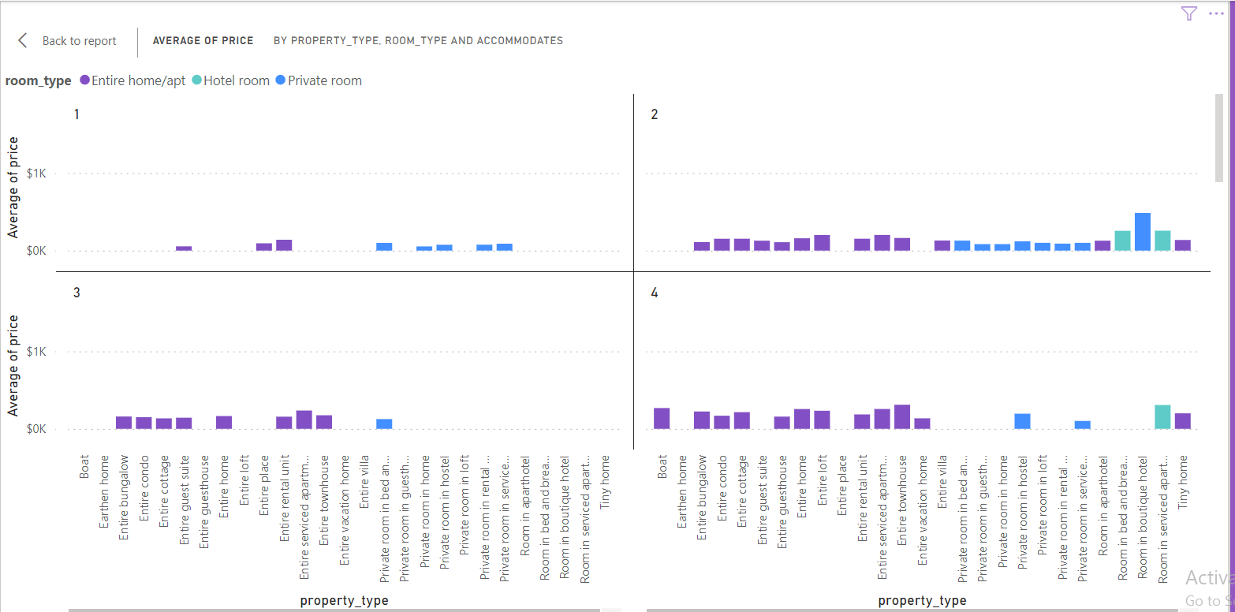
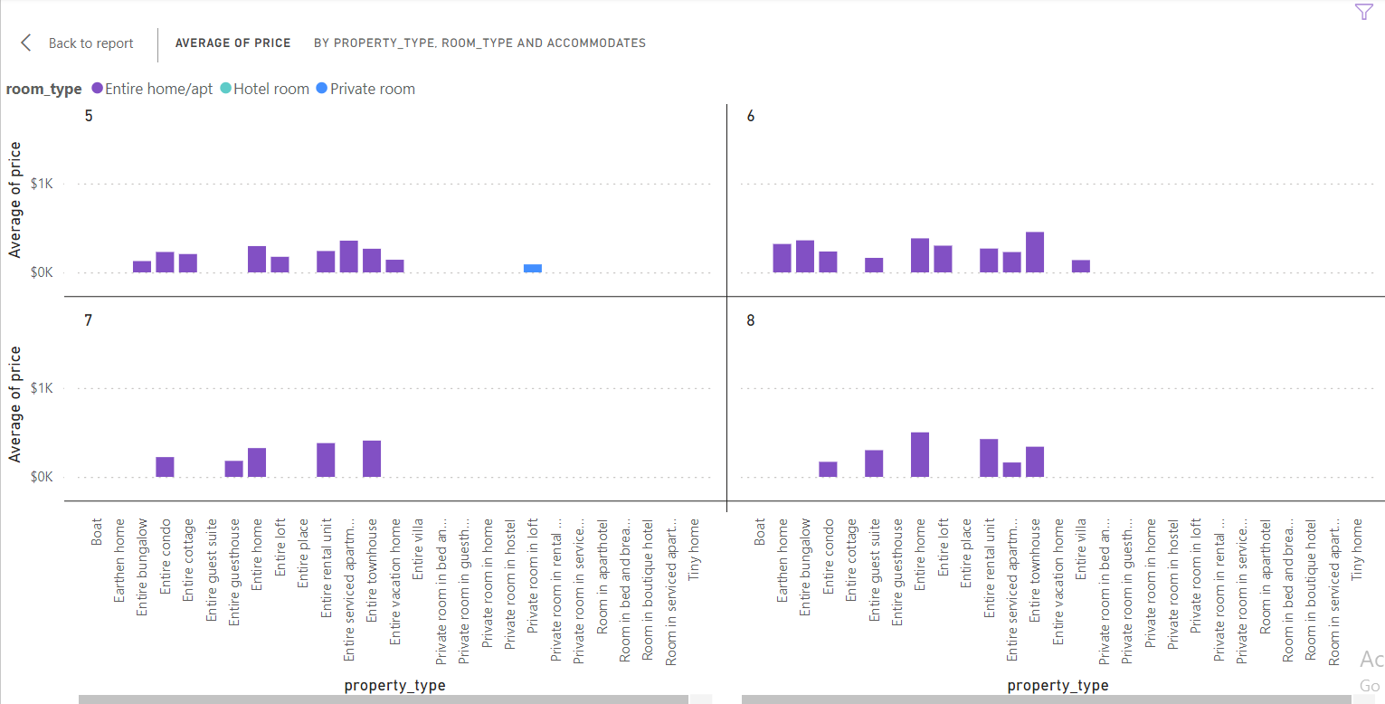
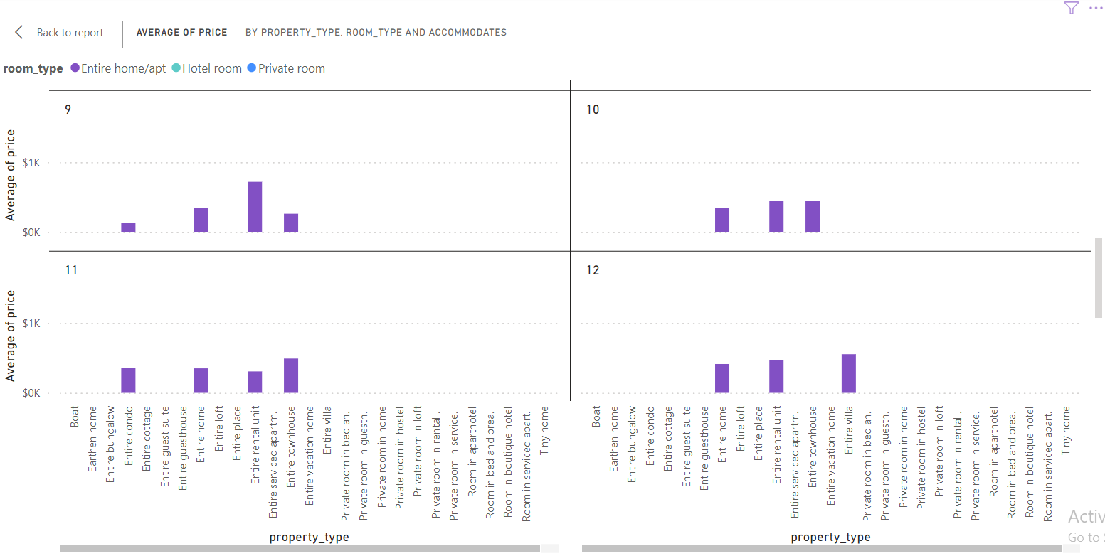
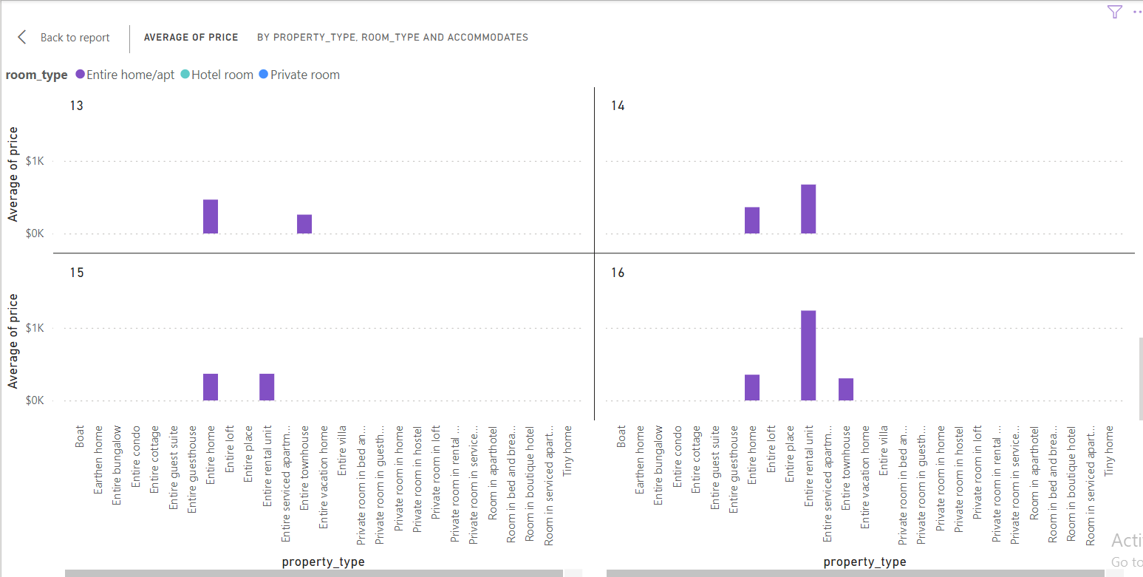
The Geographical concentration of listings and host locations
- By splitting the graph over the accommodates capacity values(1 to 16) we can find that “entire home” is the most chosen room type and it has the highest average price with property type “Entire rental unit”.

Slide 5
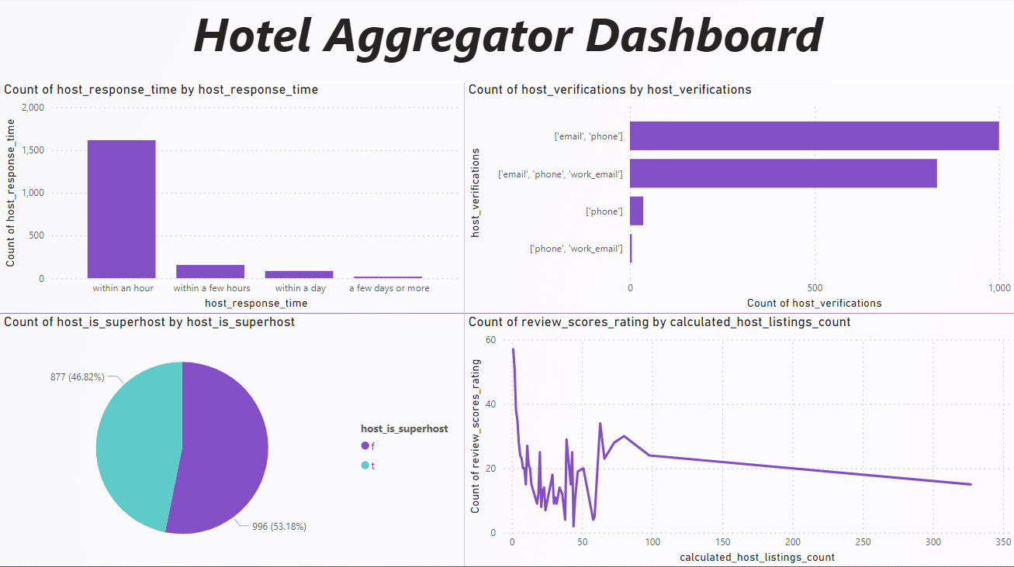
The Geographical concentration of listings and host locations
- In first bar chart we can find the most of hosts responded within one hour which is a good advantage.
- In second bar chart we can find that the most used host verification methods is (email and phone) together and the (email, phone and work email) together.
- In the pie chart we can find the 53.18% is considered as super host
- In the line chart we can find that the count of review scores rating is decreasing over the increasing of calculated host listing count.

Slide 6
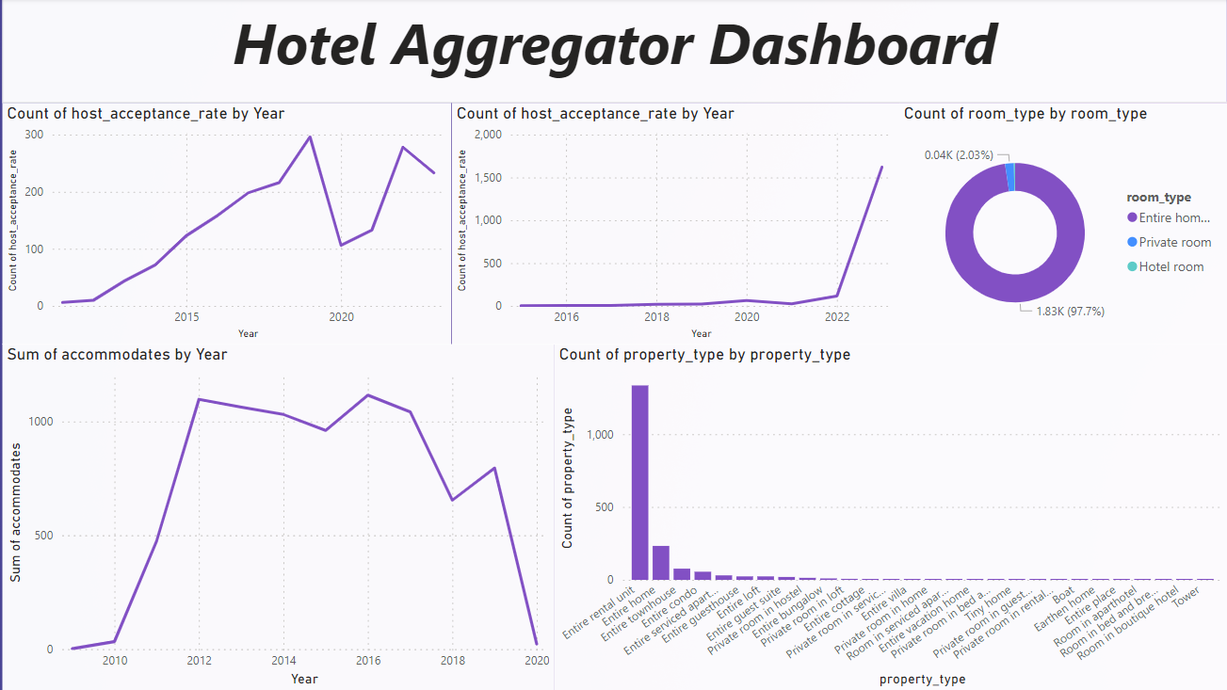
The Geographical concentration of listings and host locations
- In first line chart that express the first review we can find that the peak value was in 2019 then was a high decreasing in 2020 then high increasing again in 2021.
- In second line chart we can find that the rates start to raise from 2022.
- In the donut chart we can find the 97.7% of room type used is Entire home
- In the third line chart we can find that the peak value of accommodates was in year 2016 and after this peak it had very high decreasing started from 2017 and ended in 2020.
-In the bar chart we can find that the most property used is “Entity rental unit”.

Slide 7
Thank you

